Slide 1
Hobby Project
Benediktas Noreika

Slide 2
Introduction
-A little bit about me…
-How I approached the given specification:
An web application was needed for a to-do list application
Things needed: A cloud SQL database, backend CRUD functionality, Front end User interface using HTML and Javascript
Application approach as opposed to a website approach.

Slide 3
Consultant Journey
-Already familiar with some of the technologies required
-But many new ones learned such as:
Spring Boot framework
Bootstrap
Selenium
Considerably advanced JavaScript knowledge
SonarCube

Slide 4
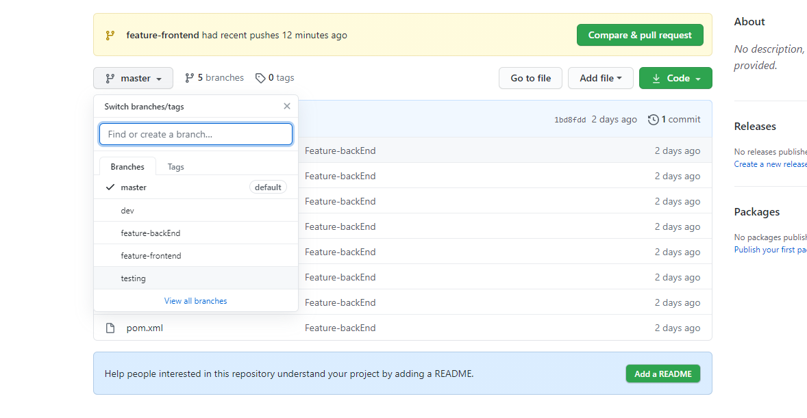
Version control
-Used git and github

Slide 5
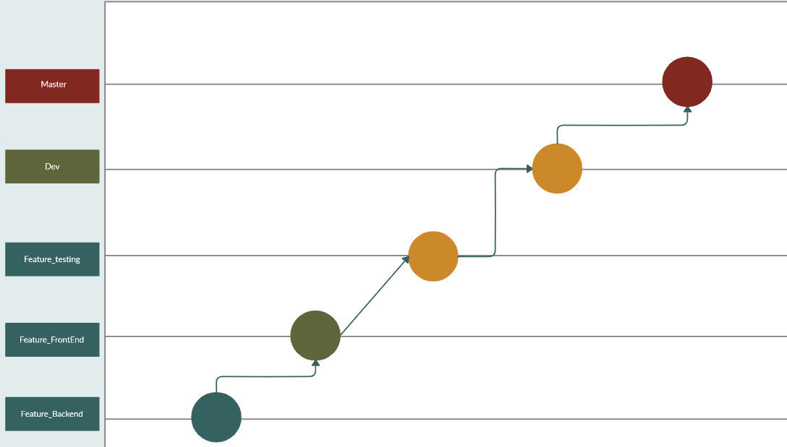
Version control - branching

Slide 6
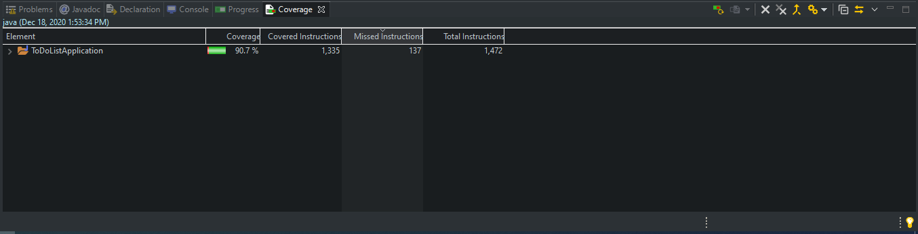
Testing
90.7 Coverage achieved.

Slide 7
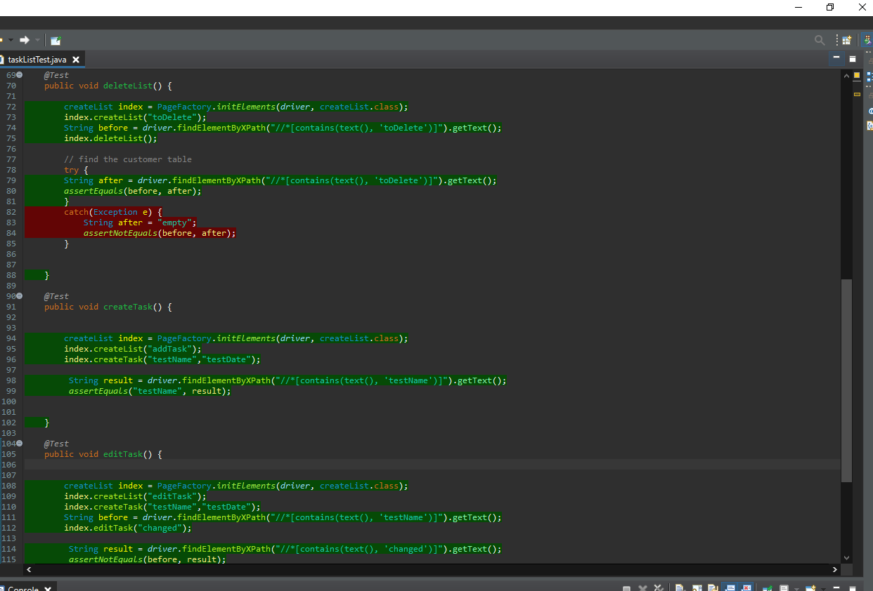
Front end testing
Done with Selenium and Junit.
User CRUD functionality tested

Slide 8
Demonstration...
User Stories…
I want to create a project task list
I want to add to the project task list
I want to complete a task in a list
I want to delete items from a task list
I want to delete a task list

Slide 9
Sprint review
-Sprints conducted in one day for one major branch due to being low on time
-Base specification requirements met set out in the project plan
-However, extra features not added in and missing a few deliverables. Such as the extent report for my front end testing

Slide 10
Sprint retrospective
-Overall the project was a success as it met its goals
-However lack of time affected me a lot in this project

Slide 11
To conclude
Future steps: Add more features such as having a complete task button
Things learned not to do next time…
Better variable naming in html files
A more test driven design

Slide 12
Thank you for listening
Happy to take any questions

